Slide 1
Expert meeting and consultations on
Enhancing Geospatial Information Management Arrangements and Accelerating the Implementation of the Sustainable Development Goals
and Sub-regional workshop on implementation of the United Nations Integrated Geospatial Information Framework for the Southern Africa
Maputo, Mozambique
24-28 March 2025

Slide 2
Country Report (Order of Presentation)
Burundi
Cameroon
Comoros
Eswatini
Lesotho
Malawi
Mozambique
South Africa
Zimbabwe

Slide 3

REPUBLIC OF BURUNDI
GEOMATIC CENTER OF BURUNDI
Coordination, management and sharing geospatial information in Burundi

Slide 4
Where are you today as a country on enhancing geospatial information?
Policy and Legal
The Geomatics Center of Burundi was created by a presidential decree of January 19, 2013. It is currently governed by the Decree No. 100/135 of September 27, 2022.
It is under the authority of the Prime Minister and manages geospatial information at the national level. His main responsibilities include the coordination of geomatics activities, the archiving and sharing of geospatial data, the quality control and metadata management. The National Geomatics Center of Burundi also develops a data catalogue and delivers geomatics visas.
Other legal and regulatory texts related to the management of Geospatial Information :

Slide 5
Where are you today as a country on enhancing geospatial information?
Policy and Legal
Other legal and regulatory texts related to the management of Geospatial Information :
The order No. 121/PM/001 of February 28, 2023 establishing the National Technical Committee for geospatial information management.
The Order No. 121/VP2/0002/2016 of February 12, 2016 instituting the geomatics visa.
The Decree No. 100/071 of 8 May 2020 creating and regulating the Steering Committee for Toponymic Standardization and the Order No. 011/121/PM of 4 August 2021 establishing the Technical Committee of Experts for geographical names standardization.

Slide 6
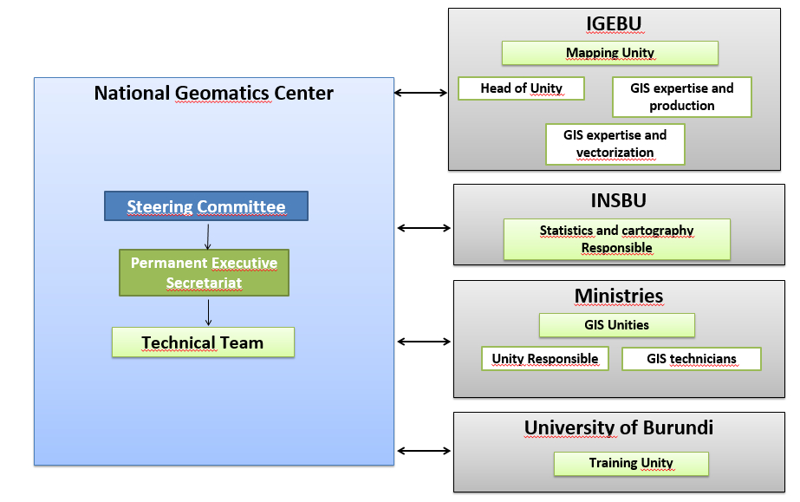
Where are you today as a country on enhancing geospatial information?
Governance and Institutions
The institutional set-up of geospatial information management in Burundi involves various actors who play key roles in the establishment of the National Geospatial Data Infrastructure.

Slide 7

Where are you today as a country on enhancing geospatial information?
Governance and Institutions
Currently, the main organizations involved in Geospatial Information management in Burundi are:
The National Geomatics Center of Burundi
The Geographic Institute of Burundi
The National Institute of Statistics of Burundi
The University of Burundi
The National Cadastre
In addition to these key actors, other national agencies also contribute to the management of geospatial information in Burundi.
The development partners, such as the Global Fund, the International Organization for Migration (IOM) , the United Nations Development Programme (UNDP), the European Union, The Food and Agriculture Organization(FAO) , The World Food Programme (WFP), The World Bank(WB), United Nations Children's Fund (UNICEF) and the United Nations Population Fund (UNFPA) play an important role in the use and production of geospatial data in the country.

Slide 8
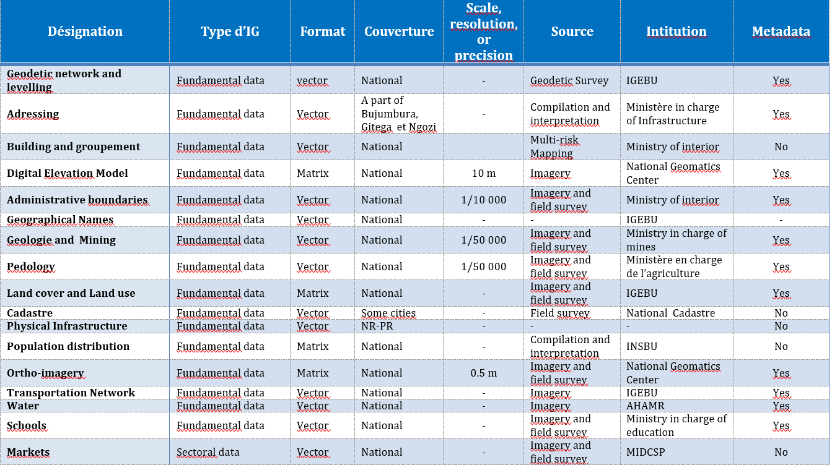
Where are you today as a country on enhancing geospatial information?
Geospatial data Centralized at National Geomatics Center of Burundi

Slide 9
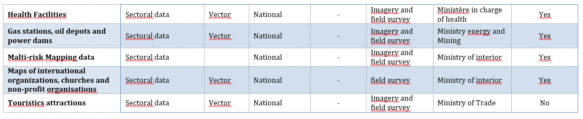
Where are you today as a country on enhancing geospatial information?
Geospatial data Centralized at National Geomatics Center of Burundi
Currently Burundi has recent data from the General Census of Population, Housing, Agriculture and Livestock, 2024 Edition. This data will be published to the public soon.

Slide 10
Where does your country want to be in the next 5 years?
The strategic objectives set for geospatial information management in Burundi come from the nine strategic pathways (United Nations Integrated Geospatial Information Framework , UN-IGIF):

Slide 11
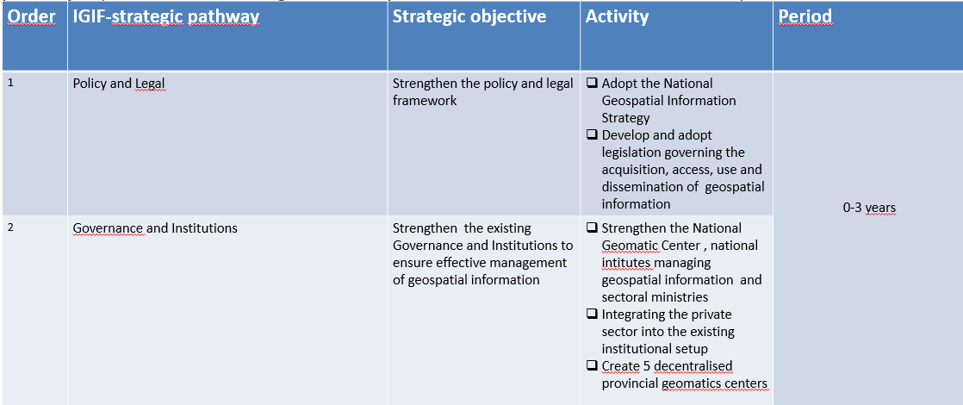
Where does your country want to be in the next 5 years?

Slide 12
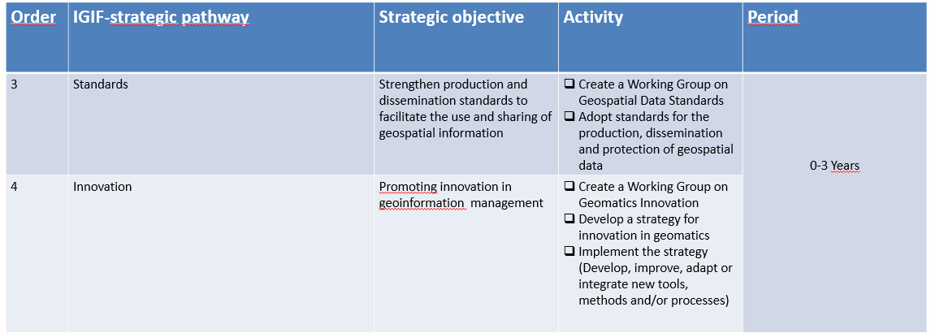
Where does your country want to be in the next 5 years?

Slide 13
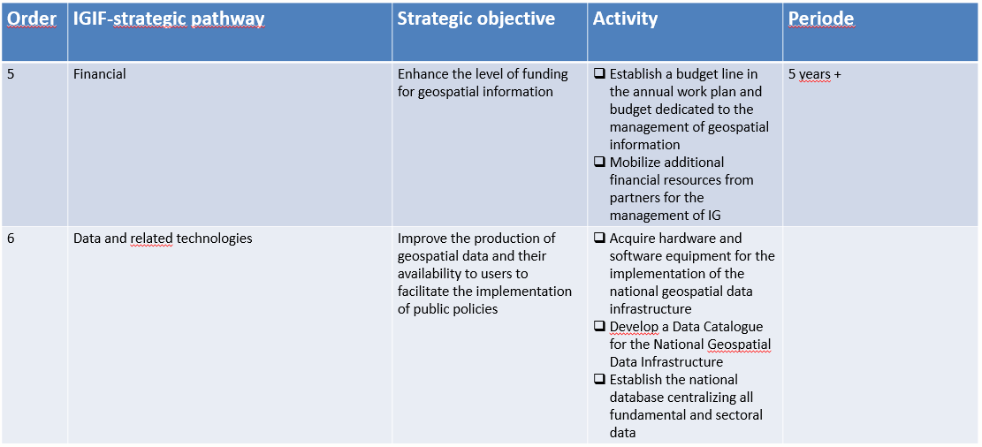
Where does your country want to be in the next 5 years?

Slide 14
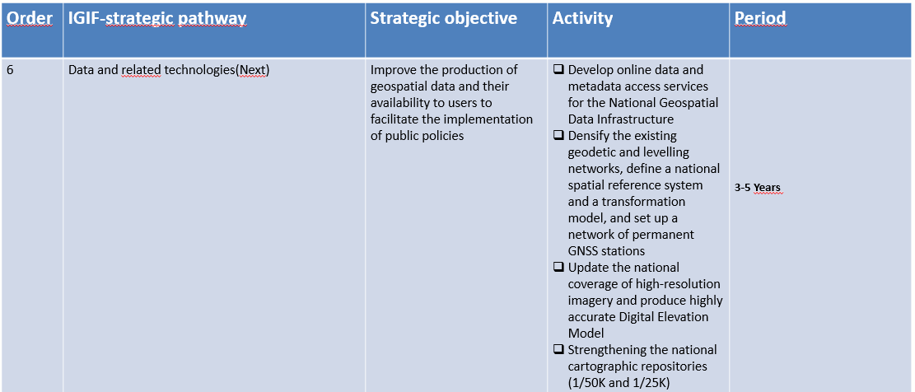
Where does your country want to be in the next 5 years?

Slide 15
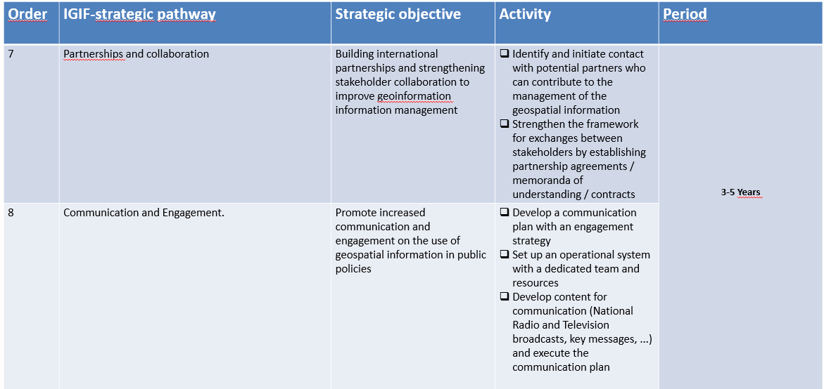
Where does your country want to be in the next 5 years?

Slide 16
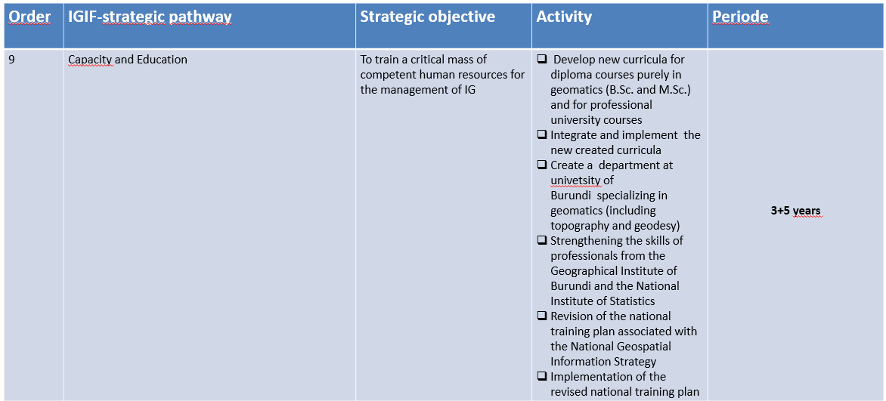
Where does your country want to be in the next 5 years?

Slide 17
What do you see as the main challenges in your country to get to this ‘ideal’ situation in the next 5 years ?
Limited skills in geospatial information management to meet the needs of the sector.
Weak technical, human and financial capacity limiting geospatial information operations.
Chronic underfunding of Geospatial Information, dependent on external funding, leading to constant difficulties in the acquisition, storage and dissemination of Geospatial information.

Slide 18
What do you see as the main challenges in your country to get to this ‘ideal’ situation in the next 5 years ?
Lack of structured and managed operational data according to industry standards in some departments and agencies, compromising their ability to effectively plan and execute their missions.
Difficulty in accessing centralized geospatial data at the Geomatics Center of Burundi due to the lack of digital tools to facilitate sharing, and non-updated and non-standardized data compromising their usefulness and relevance.
Risks related to the insufficient integration of geospatial technologies

Slide 19
Opportunities
Existence of a solid institutional and governance framework through the National Geomatics Center, promoting effective coordination of the geospatial information at the national level.
Establishment of legal bases for the coordination of geospatial information management, in particular with the National Commission on Toponymy and the application of the geomatics visa for the validation of geomatics projects.
Active communication on geospatial information through awareness-raising programs broadcast on National television and capacity building and institutional stakeholder outreach initiatives by the National Geomatics Center.
Creation of GIS units within ministries and agencies, promoting harmonized management of geospatial data and strengthening geospatial information governance.
Alignment of geospatial information with Burundi's priority public policies, ensuring effective use of geospatial information in decision-making and planning.

Slide 20

CAMEROON
NATIONAL INSTITUTE OF CARTOGRAPHY
Fernand Guy ISSERI

Slide 21



Slide 22
Where are you today as a country on enhancing geospatial information?
…The CAP has not yet been formally adopted by the Government.
…It was not the subject of a formal order from the Government.
…Does not have the support of my hierarchy
…We are considering implementing some partways within the framework of the National Statistical Information System (SNIS) projects in which the Institute is a stakeholder.
Notes:
The country's situation regarding geospatial information is somewhat ambiguous, although we already have our Action Plan.

Slide 23
Where does your country want to be in the next 5 years?
… Good governance
…The development of laws
…Our biggest challenge is the adoption of the Action Plan which will lead to a chain movement.
Building a strong partnership with the United Nations Centres of Excellence, particularly the UN-GGKIC.
Notes:
- This is a difficult question to which I cannot give a precise answer.
- The establishment of good governance and laws for which my team and I had already prepared a draft of a preliminary bill (inspired by what is happening elsewhere).

Slide 24
What do you see as the main challenges in your country to get to this ‘ideal’ situation in the next 5 years ?
Establish good governance (National Council for Geospatial Information)
Develop laws that govern the production, sharing, storage, access and dissemination of geospatial data.
The development of a stakeholder platform
Development of an economic model (to improve the quality of STATE spending)
Application development with AI integration

Slide 25
Any other opportunity/challenge?
- The UN-GGKIC is an opportunity for our countries to save time and, above all, to make a technological leap forward.
The quality of the training and, above all, the innovative tools that will be developed will allow countries to catch up and adopt new geospatial information management techniques.
Building a strong partnership with the United Nations Centres of Excellence, particularly the UN-GGKIC.

Slide 26


UNION OF COMOROS
CARTOGRAPHIC UNIT

Slide 27
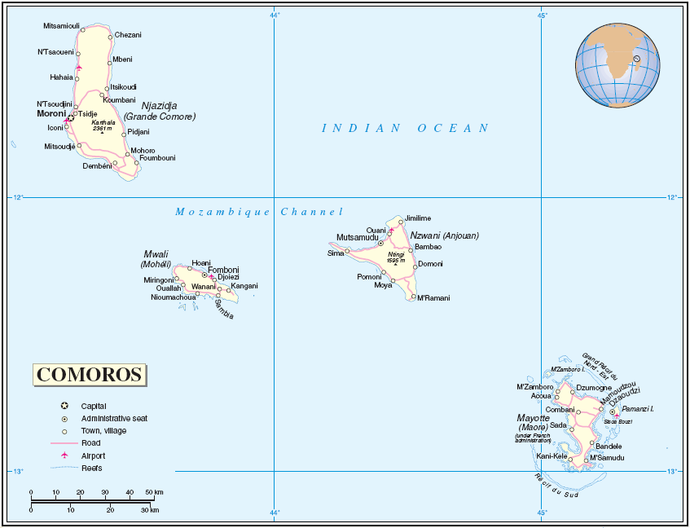
General presentation of the country
The Comoros , officially the Union of the Comoros , is a sovereign archipelago island nation in the Indian Ocean located in the Mozambique Channel off the eastern coast of Africa between Mozambique and Madagascar. Its capital is Moroni, on Grande Comore.
At 1,861 km2 (719 sq mi), the Comoros is the fourth-smallest African country by area. In 2019 its population was estimated to be 850,886..
EEZ : 160 000 km²
The Union of the Comoros has three official languages – Comorian, Arabic and French.
The country consists of three major islands and numerous smaller islands, all in the volcanic Comoros archipelago. The major islands are commonly known by their French names: Grande Comore (Ngazidja); Mohéli (Mwali); and Anjouan (Nzuwani). In addition, the country has a claim on a fourth major island, Mayotte (Maore)

Slide 28
Until 2022, there was no national repository for basic geographic data.
Topography service under the supervision of the Ministry of Finance but their work is essentially based on the realization of cadastral plans. This work is carried out by sworn surveyors
Geological Office of the Comoros:
A body responsible for developing and valorize the natural and geological resources of the country. The BGC has become the technical arm of the state in the implementation of the national petroleum project and the development of geothermal
CATI (Center for analysis and information processing) :
The Center is a service of COSEP(Emergency Operation center and Civil Protection), It has Established and manage a georeferenced database related to natural hazards and consequently to the prevention and management of disaster .
GIS department: Under the Ministry of Agriculture, Fisheries and Environmentthe Council of Government approved the establishment of an Information and Decision Support Center (GIS), in the Vice Presidency in charge of Production, Environment and Urban Planning (VIPEAU).
Where are you today as a country on enhancing geospatial information?

Slide 29
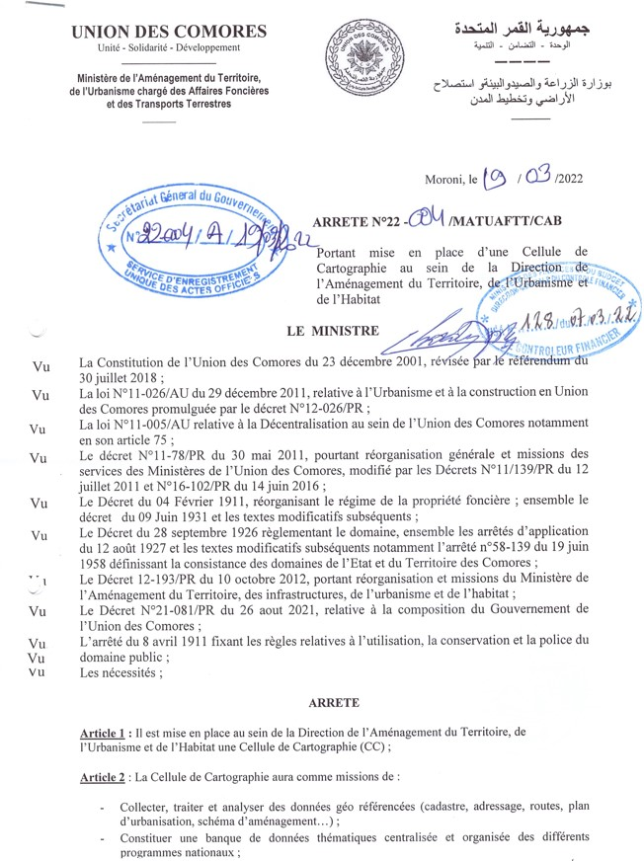
Recent creation of a cartographic unit within the ministry of territorial planning that plays the role of a national reference mapping center/agency with a reliable database such as country boundaries, infrastructure, etc.
As of 19th march 2022 the Council of Government approved the establishment of the cartographic unit within the Ministry of lands .
P l a y t he role of a reference center holder a national geo-referenced database in the absence of a national mapping agency
Serve as a forum for exchange and validation for geodata management between the different national actors
Produce maps at different scales, to support the government, local authorities and other partners in planning and implementation of public policies

Slide 30
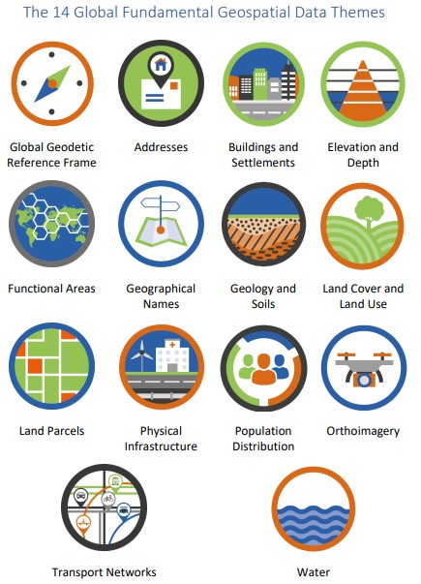
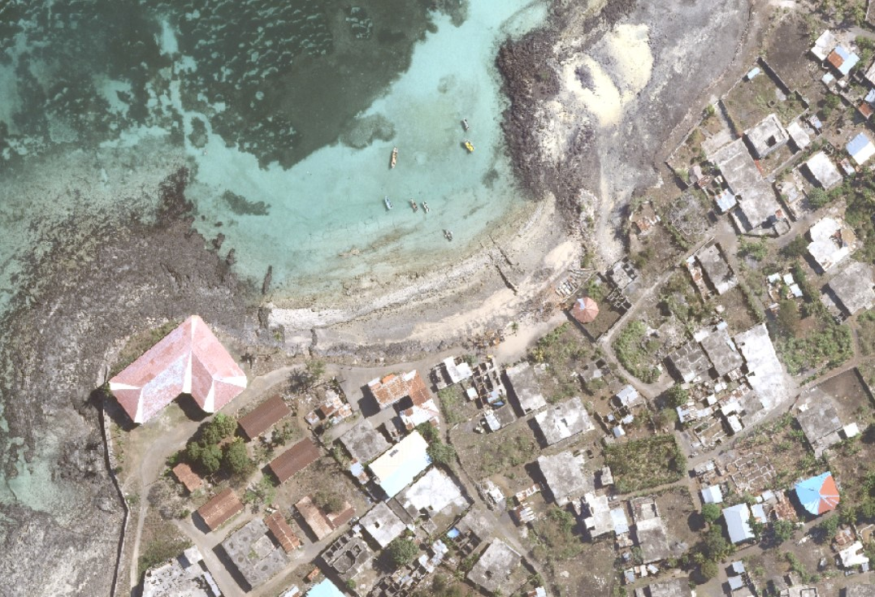
The cartographic unit has started the process of setting up a database of the 14 Themes:
Orthophotos ( 10 à 30 cm de résolution ) :

Slide 31
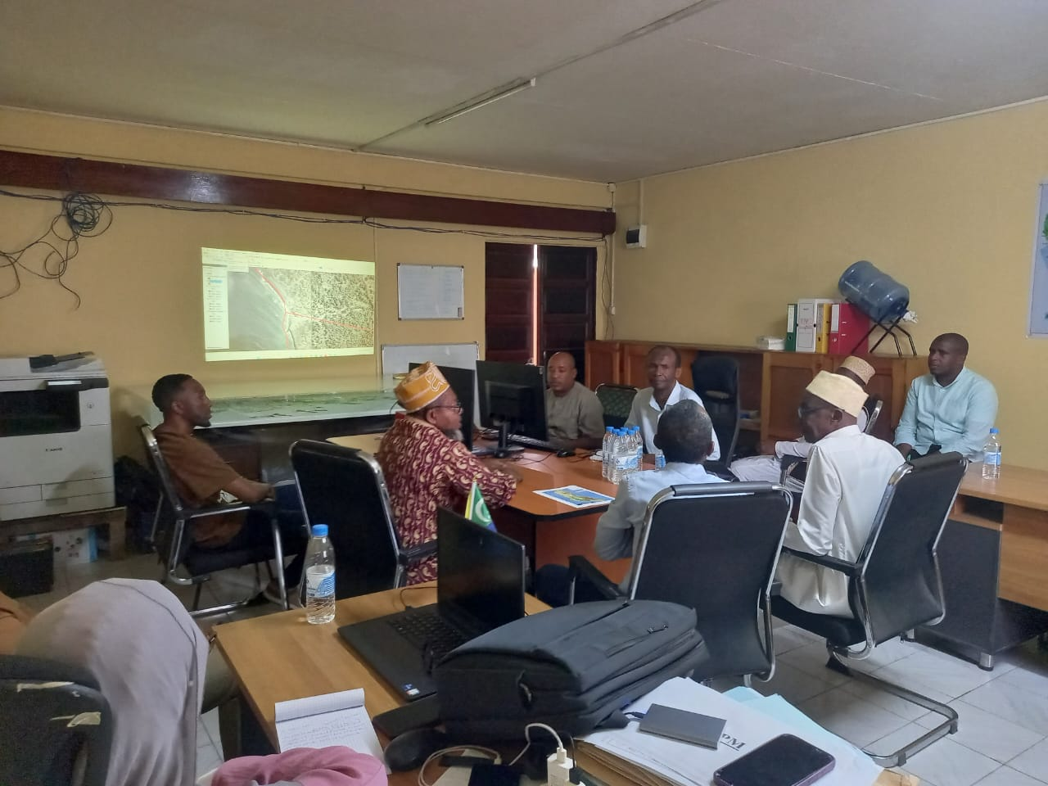
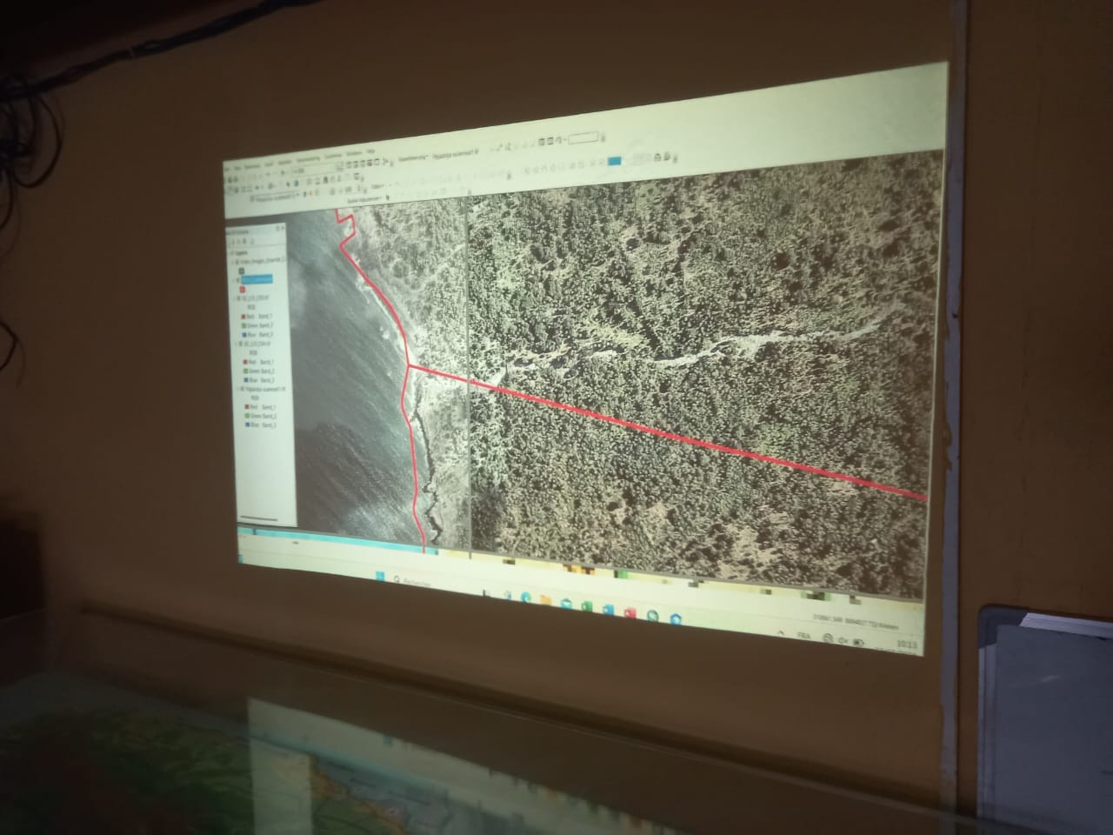
Community conflict resolution :

Slide 32
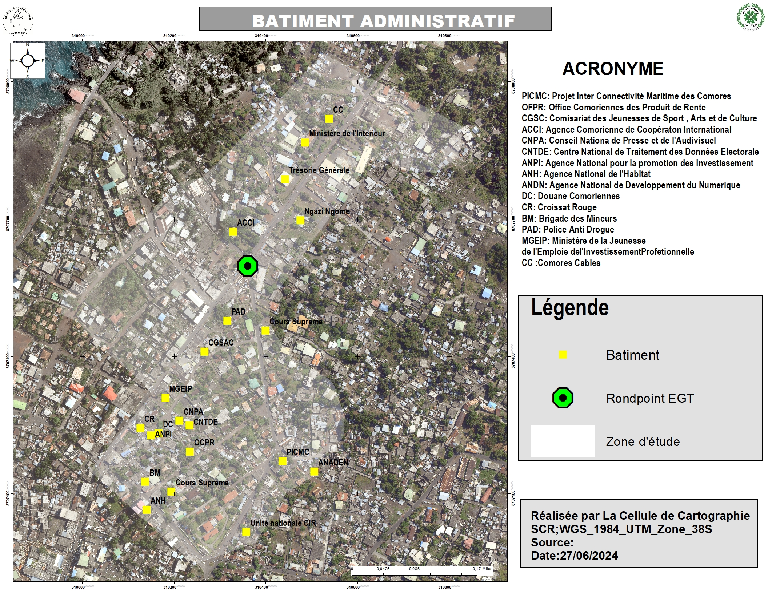
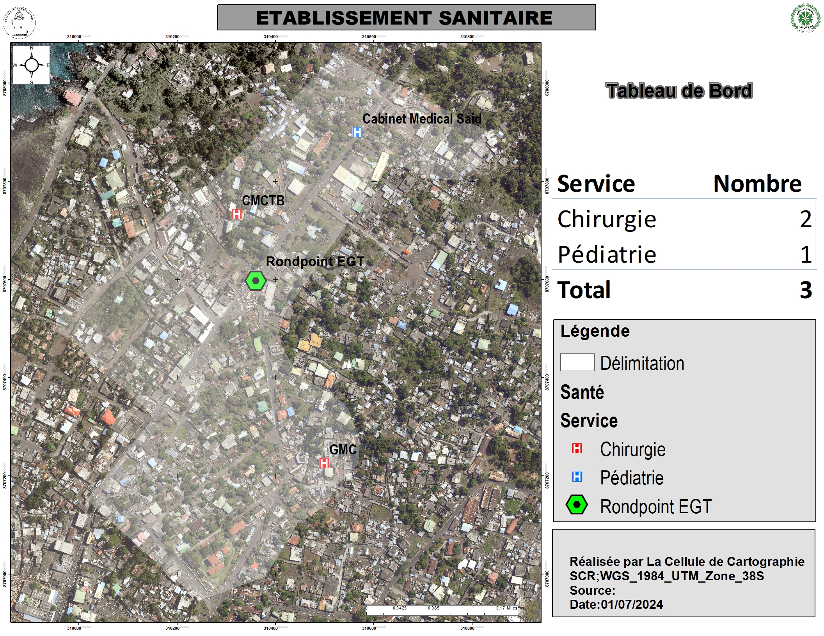
It is with this in mind that the agents of the cartographic unit are ordered to carry out a basic data collection mission in the field and from identified national institutions.
A first pilot phase will concern the following themes:
Administrative buildings
Health facilities
Education
Place of worship
Garage
Commercial equipment
Protected areas
Drilling site

Slide 33
Where does your country want to be in the next 5 years?
Finalize fundamental geo data collection in all the country
Mechanism of systematic updating data
Set up a platform for data sharing
Demystify geo data so that it can be used in an essential manner at the highest level of the state for decision-making
Explore the possibilities for geographic information management to generate economic benefits

Slide 34
What do you see as the main challenges in your country to get to this ‘ideal’ situation in the next 5 years ?
Limited human capacities
Obsolete data
No data sharing protocol between institutions
Sensitization towards decision makers
Limited funds to carry out activities

Slide 35

Marahaba Mengui !
Merci !
Thank you !
Muito obrigado !

Slide 36

KINGDOM OF ESWATINI
SURVEYOR GENERAL’S DEPARTMENT
Patrick B.S. MKHONTA
logo

Slide 37
Where are you today as a country on enhancing geospatial information?
Eswatini is at the point of completing its Country-level Action Plan (CAP) and looks forward to its implementation once completed.
No governance mechanism in place for coordinating geospatial information management between geospatial agencies.
Currently, there is no legislation for geospatial information management and no policies or laws that encourage data sharing and use of geospatial information in general.

Slide 38
Where are you today as a country on enhancing geospatial information? (cont)
No central geoportal to discover available data with its metadata.
Lack of knowledge of the importance of Standards when collecting, processing and storing data

Slide 39
Where does your country want to be in the next 5 years?
Increased awareness of the importance and value of geospatial information to the development of the country’s economy.
A governance mechanism in place to coordinate and encourage geospatial information sharing across relevant agencies
To have stablished both a legal and institutional frameworks that address geospatial information management.
A geoportal established to facilitate access to geospatial information from anywhere.

Slide 40
What do you see as the main challenges in your country to get to this ‘ideal’ situation in the next 5 years ?
A change of government whose policies may not amplify the existing development agenda.
Institutional resistance- difficulty in achieving multi-level government and cross-sector collaboration.
Data privacy and security-Reluctance of geospatial information agencies to share data and information. They have a preference for working in silos.
Notes:
Bullet 1. Come back when I have time to convince me. The momentum gained over the years
Bullet 3. They view other agencies as competition

Slide 41

MALAWI
[MINISTRY OF LANDS, DEPARTMENT OF SURVEYS]
https://www.lands.gov.mw/
logo

Slide 42
Where are we today as a country on enhancing geospatial information?
Malawi has a legal framework in place, The Malawi Geographic Information Council (MAGIC) under The Land Survey Act, 2016. Amongst others, the body has functions to:
Establish and enforce national spatial data standards.
Develop centralized and decentralized access points for spatial data.
Provide policy and technical guidance on spatial data development and management.
Support the development and maintenance of national spatial data infrastructure.

Slide 43
Where do we want to be in the next 5 years?
Integrating our geospatial information into world acceptable standards.
Advancing data acquisition technologies, such as using airplanes for photogrammetric work and drones for capturing imagery to address various challenges, including natural disasters like floods.
Enhancing aerial data processing capabilities to better analyze and utilize collected data.
Ensuring that spatial data coverage of Malawi, along with map series at various scales, is comprehensive and accessible, supporting economic development through multiple projects.
Integrating advanced geospatial programs into tertiary education, including courses in remote sensing and GIS, to develop a skilled workforce.
Establishing a robust GIS server to efficiently store, manage, and share all spatial data across government, research, and development sectors.

Slide 44
What do we see as the main challenges in our country to get to this ‘ideal’ situation in the next 5 years?
To reach the ideal geospatial landscape in the next five years, Malawi faces several challenges:
Limited advanced training in key data-producing fields like Remote Sensing (RS) and GIS.
Gaps in data analysis skills, particularly in programming languages such as Python, R, and JavaScript.
Insufficient resources for data collection, including vehicles for capturing imagery.
Outdated syllabuses that lack advanced geospatial technologies.
Weak internet and ICT infrastructure, hindering access to online data and web mapping tools.
Low awareness among decision-makers and the public, leading to under-utilization of GIS technology.

Slide 45
Any other opportunity/challenge?
The Malawi Spatial Data Centre (https://www.masdap.mw/) is a data-sharing portal, used by MAGIC. Needs further enhancements, dedicated members and funding).
Partnerships between government, private companies, academic institutions and other international organizations.
Creation of Land Information Management System in Malawi to provide services in land administration and manage geo-information in Malawi for security of tenure.
Establishment and operationalization of Continuously Operating Reference Station for hamonisation of African and World Datasets.
Availability of base map data and map series at various scales provides a solid foundation for further geospatial advancements and development, enabling better planning and decision-making.

Slide 47
MOÇAMBIQUE
AGÊNCIA NACIONAL DE DESENVOLVIMENTO GEO-ESPACIAL

Slide 48
Where are you today as a country on enhancing GI?
Através da Lei 3/2023 - 24 Março, Parlamento autorizou GoM a criar IDEMOC
IDEMOC criada por Decreto-Lei 2/2023 6 Nov
ADE, IP, com mandato de promover a produção harmonizada, uso and disseminação de toda informação espacial actualizada e com qualidade
No processo de operacionalizar a IDEMOC cujo plano de acção deve ser harmonizado com CAP
1o Comité Nacional presidido pela PM por ser agendado para finais Abril’25

Slide 49
Where does your country want to be in the next 5 years?
Plataforma com dados actualizados com a precisão e resolução adequadas para suporte aos processos de tomada de decisão e desenvolvimento
Plataforma de referência, dotada de recursos tecnológicos e humanos de qualidade e suportada por uma ampla rede de entidades promotoras
Modelo de gestão efectivo e inclusivo, dotado de competências e recursos financeiros adequados

Slide 50
What do you see as the main challenges in your country to get to this ‘ideal’ situation in the next 5 years ?
Apropriação por parte da Liderança e instituições capacitadas
Uso efectivo da IG em todo processo de planificação e decisão
Regulamentação efectiva – produção, partilha e uso de dados com padrões e qualidade
Modelo de Negócio e Financiamento

Slide 51
UN-INTEGRATED GEOSPATIAL INFORMATION FRAMEWORK
IMPLEMENTATION IN SOUTH AFRICA
Date: 24 March 2025
Presenter: Clinton Heimann

Slide 52


National Policy Directives
Coastal
SASDI
Marine
Terrestrial
Constitution
National Spatial Observatory
National Spatial Data Infrastructure
National Spatial Action Areas

Slide 53

The South African Spatial Data Infrastructure (SASDI) as the national, technical, institutional; and policy framework to regulate the collection, management, maintenance, integration, distribution, and use of spatial information for improved socioeconomic development.
The Committee for Spatial Information (CSI). Established in terms of section 5 of the Spatial Data Infrastructure Act, Act 54 of 2003. The role of the CSI: to advise the Minister, the Director General or an organ of state dealing with spatial information on any matter the CSI considers necessary or expedient for achieving the objectives of South African Spatial Data Infrastructure (SASDI).
The SDI Act
establishes:
An Electronic Metadata Catalogue

Slide 54



COMMITTEE ON SPATIAL INFORMATION ROADMAP
2020
2021 -
Quarterly reporting sessions, revamp of EMC with DCPR incorporation, and review/approval of Themes to align with UN-GGIM's Fundamental Geospatial Data Themes.
3rd CSI Inauguration
2018
2019
Considerations for capturing spatial information according to Regulations 5(2) and Standards identification for publication under section 11 of the Act.
Form D and F considerations, launch of SASDI Website (www.sasdi.gov.za), and approval of SDI terminologies.
2016
2017
Policies Published on Data Custodianship and Pricing, Full Regulations Published, CSI Code of Conduct Approved
Approval of CSI Code of Conduct, Ministerial approval of Land Cover Standard, Metadata Training, 1st Compliance Audit, Appointment of Coordinators, Custodians for base data sets appointed, Base Data Set Governance Model established, and regulations for section 5 published.
2012
2015
Data themes, datasets, and custodians identified with prioritization of 10 themes.
2nd CSI Inauguration
SDI Act implemented fully
Published policies on data custodianship and pricing of spatial information products and services
2008
2010
Section 5 Committee Establishment Regulations Published
1st CSI Inauguration
2006
Sections 1 to 11, 13, and 19 to 22 of the Act are now in effect.
2004
The Spatial Data Infrastructure Act was assented

Slide 55

UN-IGIF INSPIRED STRATEGY (2022 - 2025)

Slide 56
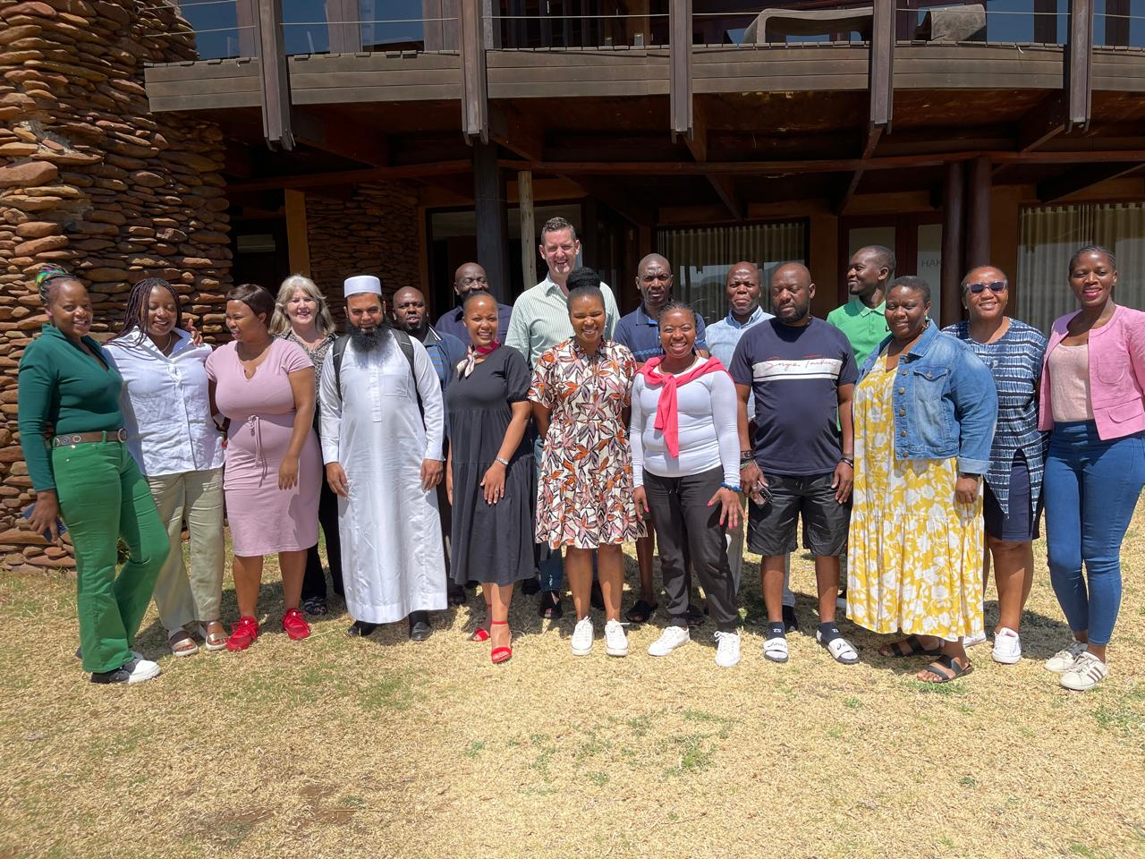
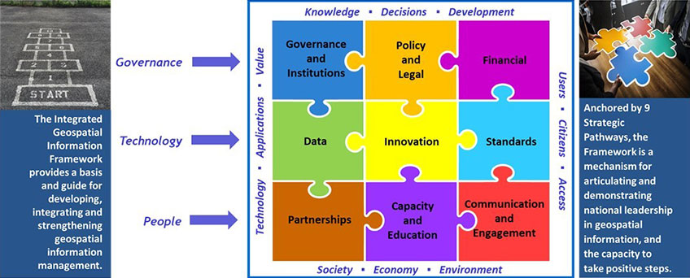
MAGALIES DECLARATION

Slide 57
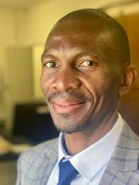



GOVERNANCE STRUCTURE
Morena Letsosa
Chairperson
CSI
Michael Manyama
Marlanie Moodley
S’lindile Mhlongo
Chairperson: Governance Subcommittee
Chairperson: Technology Subcommittee
Chairperson: People Subcommittee
Members of the CSI
Office of the Secretariat
Morena Letsosa - Rep SAGC
Michael Manyama - Rep SAPO
S’lindile Mhlongo - Rep ESKOM
Marlanie Moodley - Rep DFFE
Rajesh Makan - Rep the Minister
Serena Coetzee – Rep CHE
Flora Makgale - Rep a Rural DM
Gareth Muthumuni - Rep DPME
Terence Turnbull - Rep SANDF
Tumisang Modiole - Rep DSI
Ndiyafhi Denge - Rep Limpopo Province
Working Groups
Working Groups
Working Groups
Clinton Heimann
Nontuthuzelo Ntshabele
Maroale Chauke
Vutomi Ndlovu
Serati Mashamaite
Governance and Institutions
Data
Partnerships
Policy and Legal
Innovation
Capacity and Education
Financial
Standards
Communication and Engagement
An enabled environment for the capture, use, sharing and maintenance of geospatial information
A standardized Data, Processes and Technology
A nation that is geospatially aware and engaged
Outcomes

Slide 58
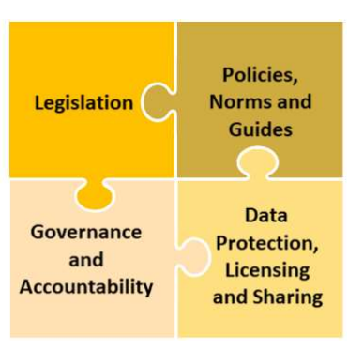

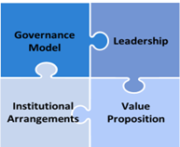

Status-quo: legislation, regulations and policies in place
Challenge(s): legislation is outdated and lack some key elements of GIM.
Plan: Repeal the SDI Act to ensure alignment with international frameworks. Review regulations to ensure efficiencies in the management of geospatial
information
Status-quo: Two policies in place (Custodianship and Pricing of data) Challenge(s): SASDI Guidelines are still in draft format.
Plan: More policies identified by the CSI for development and the SASDI Guidelines to be finalised for approval by the Minister.
.
Status-quo: the current policies promotes good governance and accountability.
Status-quo: Several good laws in terms of data protection (Copyright Act, POPI, etc) exist. Some of these elements are included in the SDI Act.
Challenge(s): Lack of implementation and poor enforcement of polices results in lack of governance and accountability
Plan: Repeal the SDI Act to include penalties and filter penalties to policy level.
Challenge(s): Lack of implementation and poor enforcement of polices results in lack of governance and accountability
Plan: Repeal the SDI Act to strengthen the data protection, licensing and sharing elements.
Status-quo: governance model is in place established through the SDI Act, and managed through regulations policies, standards and guidelines.
Challenge(s): Not at the level as prescribed by the IGIF and currently applies only to organs of state.
Plan: Repeal the SDI Act to ensure
interrelated relationship and
partnerships across.
Status-quo: leadership structure in place in the form of a statutory body ( Committee for Spatial Information ).
Challenge(s): participation excludes other critical thematic bodies such as the private sector and civil society.
Plan: Repeal the SDI Act to ensure inclusion of.
Status-quo: A National Address Dataset project has been identified to evaluate potential components of a future business model. An agenda item already booked with Cabinet to present proposals.
Challenge(s): current funding approach not sustainable and adequate
Plan: Develop a funding model for
Cabinet approval
Status-quo: No formal and well-coordinated techniques and methods for aligning integrated geospatial use cases with national strategic policy
Challenge(s): Lack of firm motivation for funding for some data custodians)
Plan: Develop more use cases to support the national strategy (e.g. National Address Dataset project
of the private sector and other key stakeholders.
Status-quo: institutional arrangements in place. All structures of the CSI are made up of members from various organs of state.
Status-quo: value proposition within the national strategy not in place yet.
Status-quo: some data custodians receives investment from government. No private sector investment in place
Status-quo: No plan in place to measuring and evaluating the benefits of a national integrated geospatial
Challenge(s): Lack of instruments to showcase GI as a valuable government asset.
Plan: Strategy development including the Country-Level Action Plan to be development the current year. Delays within the procurement process.
Challenge(s): Lack of diverse funding sources for SASDI
Plan: Encourage private sector participation and explore funding sources and options
information management program.
Challenge(s): Lack of a Country-Level Action Plan
Plan: Prioritize the development of the South African Geospatial Information Management Strategy.
Challenge(s): exclusive to organs of state. A drive to be inclusive.
Plan: Repeal the SDI Act to ensure interrelated relationship and partnerships across

Slide 59
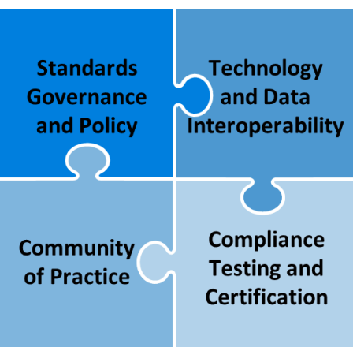


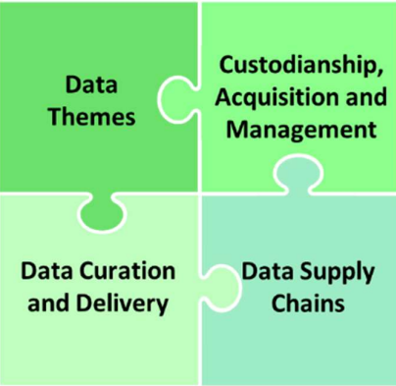
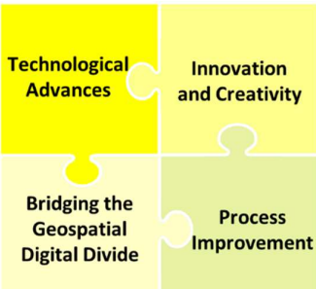
Status-quo: standards governance and policy in place. Standards are gazetted for implementation by the Minister. Standards are sourced from SABS, ISO and OGC and made available to custodians for implementation. Challenge(s): Lack of understanding and implementation of standards.
Status-quo: Data interoperability in place especially for data custodians contributing data within one data theme.
Challenge(s): Technology interoperability still a challenge
.
Plan: formulate guidelines to encourage different technologies, systems, and geospatial data to work together seamlessly.
Plan: Capacitate organs of state in standards. Capacitate the office to provide support to organs of state.
Status-quo: no community of practice to accelerate the benefits of standards and interoperability through standard-based good practices.
Status-quo: Compliance testing and certification to ensure proper implementation of standards not in.
place
Challenge(s): New process to be established with the SABS and OGC including benchmarking with other countries.
Plan: Capacitate the office to provide support to organs of state.
Challenge(s): Lack of understanding of standards.
Plan: Capacitate the office to provide support to organs of state.
Status-quo: 14 Data themes aligned to the globally endorsed fundamental geospatial themes. Base Data Coordinators and custodians formally appointed
Challenge(s): Inadequate technical support and training to coordinators and custodians (e.g. metadata and standards training). Current APP Target of 12 with over 600 to support.
Status-quo: Custodianship responsibilities allocated to the data coordinators and data custodians in accordance with their respective legal mandates.
Challenge(s): Principles of data custodianship not adhered to. Some custodians still struggle to understand their roles and responsibilities.
.
Status-quo: drone technology has brought the new industrial paradigm to produce, share, analyze and deliver information to enrich knowledge economies.
Challenge(s): the need to formulate or adopted international standards
Plan: Appoint a base data custodian
for drone data. Develop/ adopt and
implement standards.
Status-quo: digital transformation strategies, policy and legal instruments and innovation centers not in place.
Challenge(s): the uptake of GIM was very slow in the last ten years including lack of funding.
Plan: Funding for research and innovation in
place. Engagements are held with
institutions of higher learning to
partner in developing the digital
transformation strategy.
.
Plan: Capacitate the office to provide support to organs of state.
.
Plan: Capacitate the office to provide support to organs of state.
Status-quo: process to support data curation and ensure data is continually
Status-quo: the gap between organisations that have access to modern geospatial and innovative
ICTs and those that do not have is not known.
Status-quo: processes to achieve efficiencies, productivity
gains and new products and services not in place yet.
.
update, retrievable for future purposes
in place. Base Data Custodianship Policy Challenge(s): Lack of implementation and poor enforcement of polices results in lack of governance and accountability
Plan: Capacitate the office to provide support to organs of state. Repeal the SDI Act and penalties
Status-quo: Data supply chains processes not in place
Challenge(s): Inadequate technical support and training to coordinators and custodians in preparing their data management plans.
Plan: Capacitate the office to provide support to coordinators and custodians.
Challenge(s): new initiatives and new products and services are not coordinated
Plan: formulate processes on new developments as well as improvements to existing processes and
systems.
Challenge(s): Lack of resources to conduct a full-scale assessment of the digital divide, especially in local municipalities.
Plan: Partnership with Universities to conduct research.

Slide 60
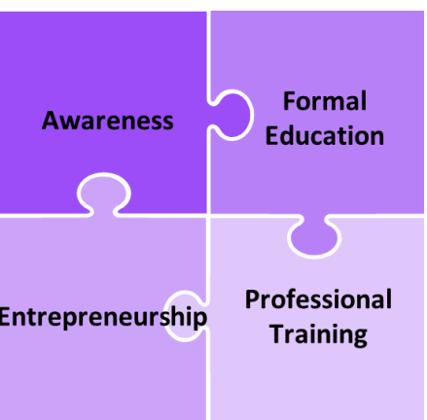


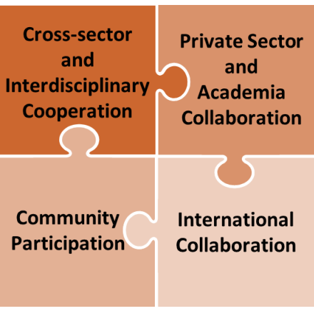
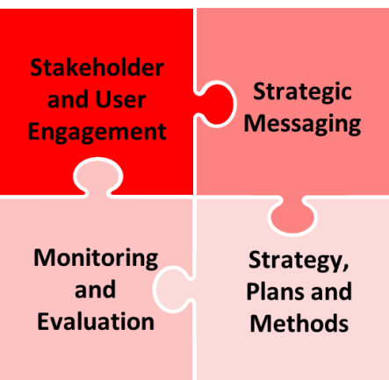
Status-quo: no contact and/or online courses available promoting the needs and benefits of geospatial information.
Challenge(s): Engagements with institutions of higher learning taking longer than expected
Plan: Continue to facilitate engagement
and formalize arrangements
with institutions of higher
learning.
Status-quo: Formal education not aligned with industry needs.
Challenge(s): Lack of partnership between industry and institutions of higher learning .
Plan: Continuous engagements with the Academia and formalise collaborations through MoUs
Status-quo: Few new entrants in
Geospatial industries.
Status-quo: professional training including hand-on training provide on Data Quality and Metadata standards
Challenge(s): current systems does not encourage capacity through innovative and creative applications,
Challenge(s): Professional training on other elements of the IGIF is lacking.
Plan: Outsource some of the professional training to institutions of higher learning.
, design and launch of start-ups.
Plan: growing the digital economies underpinned by geospatial information.
Status-quo: Cross-sector and interdisciplinary cooperation not existing. (e.g. Geo and Stats)
Challenge(s): lack of benefit form economies of scale and interdisciplinary knowledge sharing.
Plan: Continuous engagements
and value proposition.
.
Status-quo: Private sector and Academia collaboration engagement started
Challenge(s): Lack of trust between government and private sector organisation.
Status-quo: no established stakeholder and user engagement process.
Challenge(s): communication is haphazard and adhoc
Plan: Develop and stakeholder engagement plan.
Status-quo: Two policies in place (Custodianship and Pricing of data) Challenge(s): SASDI Guidelines are still in draft format.
Plan: More policies for development identified by the CSI and the SASDI Guidelines to be finalised for approval by the Minister.
.
.
Plan: Continuous engagements with the Private sector and Academia and formalise collaborations through MoUs
Status-quo: community participation in some areas. Drone awareness campaigns at schools.
Status-quo: International collaboration commenced with OGC. Engagements underway with
Status-quo: the current policies promotes good governance and accountability.
Status-quo: The country have good laws in terms of data protection (Copyright Act, POPI, etc). Some of these elements.
Challenge(s): Crafting message to the level of audience.
Plan: Capacitate the office and host more community outreach events.
Mozambique and Zambia to benchmark and identify areas of collaboration.
Challenge(s): International relations protocols in GI concepts not yet fully established
Plan: Capacitate the IR office of possible collaborations in GI.
Challenge(s): Lack of implementation and poor enforcement of polices results in lack of governance and accountability
Plan: Repeal the SDI Act to include penalties
included in the SDI Act.
Challenge(s): Lack of implementation and poor enforcement of polices results in lack of governance and accountability
Plan: Repeal the SDI Act to strengthen the data protection, licensing and sharing elements.

Slide 61


[COUNTRY] [AGENCY]
MINISTRY OF LANDS, AGRICULTURE, FISHERIES, WATER AND RURAL DEVELOPEMNT
ZIMBABWE
BY
PLS Cephas Magauze

Slide 62

Birth of the DSG and Land Records Mandate
…background
Land Survey Act [20:12]
1st May 1933 …… ‘consolidation of existing laws relating to the survey of land’
Part V ……Establishment of the Office of the Surveyor General
Section 7(1)(c) ‘take charge of and preserve all records appertaining to surveys of land which were, prior to 1st May 1933 preserved as records in the S.G’s office, or which may become, after such date , records of the S.G’s office’
…obligation to avail such records/information/data when requested to do so by any person

Slide 63



Where are you today as a country on enhancing geospatial information?
DSG (and Deeds) datasets being computerized and availed online.
Approx 2,5 million land parcels title surveyed ~25% of the Country
80% registered with Deeds Registry Office.
Web based E-cadastre platform
Online access and dissemination of geospatial information.
Integration of MDAs.

Slide 64



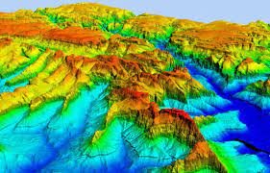
Where are you today as a country on enhancing geospatial information.. ? Cont..
Phantom 4 Pro
Topographical Map Series
1:1 000 000 (whole country)
1:250000
1:50000 (584 sheets whole country except national parks)
1:25000 (NEW MAP SERIES hard copy +shapefiles)
1:10000
1:5000 (urban)
Satellite imagery
DTM

Slide 65


Where does your country want to be in the next 5 years?
Zimbabwe :towards the Digital age
Smart City
Complete Digital base layer: Cadastral and maps
3D cadastre for major Cities
Control Network (CORs)-Whole Country (60)
Updated maps: Topography, tourism, navigation etc
Integration of Land Information Systems
Digital dissemination and sharing of Land Information
Surveyed Communal, Urban and rural land by year end 2026
Full fledged e-cadastre-NSDI-eGovernance

Slide 66

What do you see as the main challenges in your country to get to this ‘ideal’ situation in the next 5 years ?
Competing needs to financial resources
Ideal structures to coordinate geospatial information acquisition and sharing.
High Costs of Data Collection
Training and availability of experts
Bringing together different MDA (different database systems, data formats
Legislative changes/enhancements
Different coordinate systems…
Volunteers

Slide 67
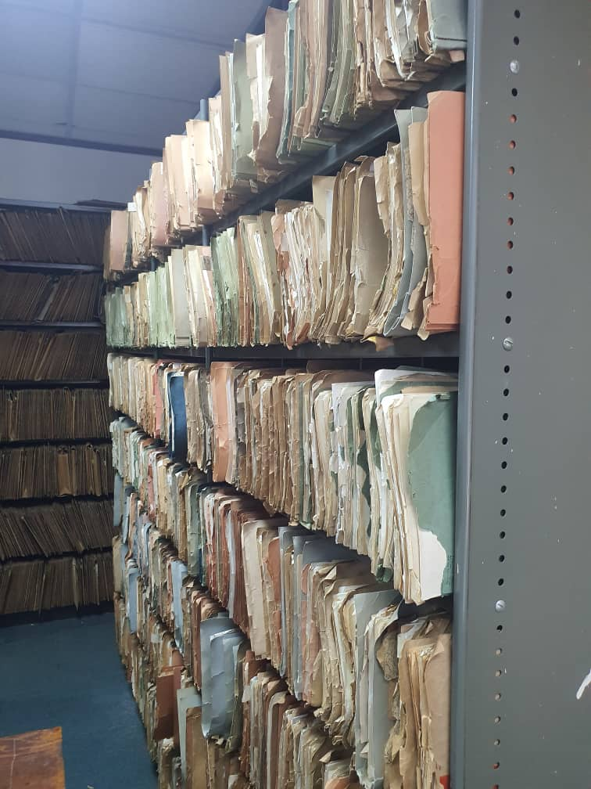


Any other opportunities
Any other challenge?
Bringing all MDAs
Thousands of documents deteriorating through wear-and-tear
Connectivity issues and costs
Difficult to Share: this seriously affects the ease and cost of doing business (MDA’s unstandardized silos challenge)
Scattered datasets (SG and Deeds)
Government support (LTIP), International Agencies.
Government approval for NSDI
Existing data sets in different MDA, private players
Robust cadastral and mapping datasets

Slide 68


